Slide 1

Capstone Project: Loan Creditworthiness Forecast
Abdul Rahim bin Saidi

Slide 2
Today, we're embarking on a journey to explore the realm of lending and loans!
Problem Statement:
Identify key factors affecting loan approval decisions and leverage data-driven insights to improve lending institutions' decision-making accuracy and efficiency. We aim to explore traditional and innovative methods to provide actionable solutions for addressing loan eligibility challenges.
Causes, Effects, and Scope of the Problem:
The problem arises from the complex interaction of factors like credit scores, income, and employment status affecting approval. Its effects are significant for both lenders and borrowers. Lenders aim to minimize defaults while providing fair access to credit, and borrowers seek financial assistance for various needs. This problem's scope encompasses the entire lending industry's role in promoting economic growth and financial stability. Our goal is to explore innovative solutions and communicate findings effectively.

Slide 3
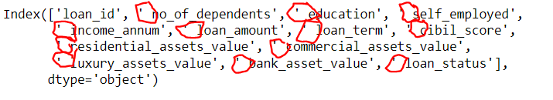
Data Gathering and Preparation
In our analysis of the loan approval dataset created by Kai on Kaggle.com
Information about the columns:
loan_id
no_of_dependents: Number of Dependents of the Applicant
education: Education of the Applicant (Graduate/Not Graduate)
self_employed: Employment Status of the Applicant
income_annum: Annual Income of the Applicant
loan_amount: Loan Amount
loan_term: Loan Term in Years
cibil_score: Credit Score
residential_assets_value
commercial_assets_value
luxury_assets_value
bank_asset_value
loan_status: Loan Approval Status (Approved/Rejected)
1. Check for Missing Value -> No Null Values
2. However, upon closer inspection, we've noticed a minor detail related to the column names.

Slide 4
Exploratory data analysis (EDA) & Modelling

Slide 5
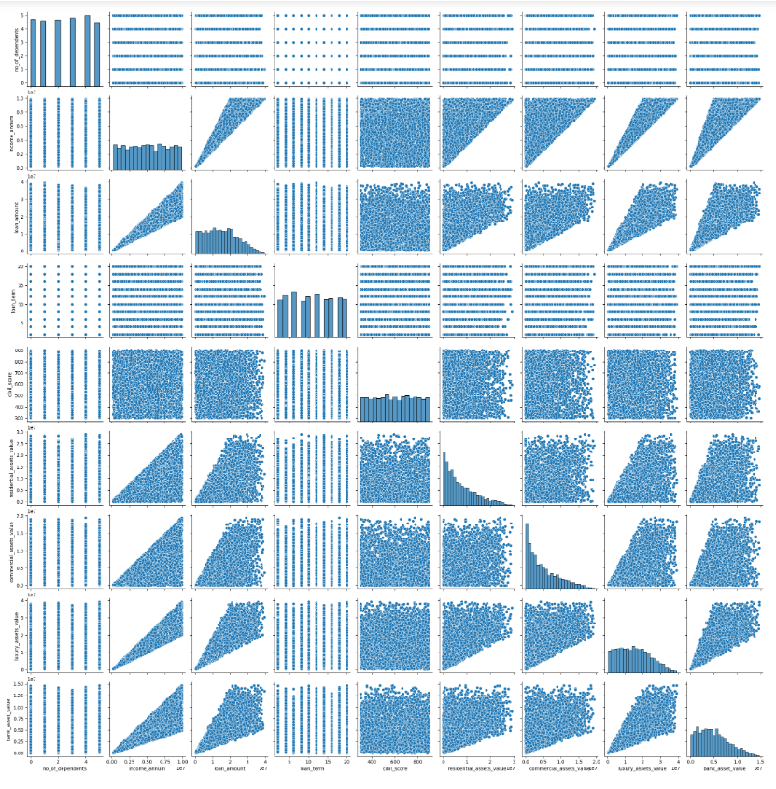
Exploratory data analysis (EDA) & Modelling

Slide 6
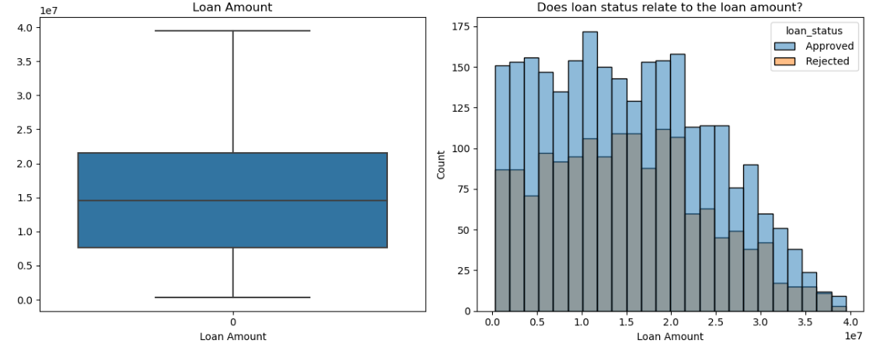
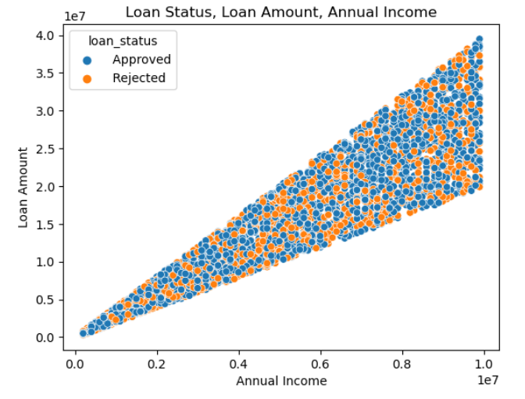
Exploratory data analysis (EDA) & Modelling
There's a positive correlation between annual income and loan amount, where higher income is associated with larger loans.
Annual income doesn't exhibit a clear trend regarding loan status.
Applicants with lower annual incomes have a narrower range of loan amounts, while those with higher incomes have a broader range.
Applicants with the highest annual income can be approved for the highest loan amounts, but they may also face rejection for lower amounts.
This intriguing pattern could be due to various lenders' policies and unique applicant conditions. Further analysis is needed for deeper insights.
Interestingly, approved and rejected loans show similar trends in relation to loan amounts. The histogram suggests no strong link between loan status and loan amount. Let's investigate other factors like annual income.
Loan status and loan amount

Slide 7
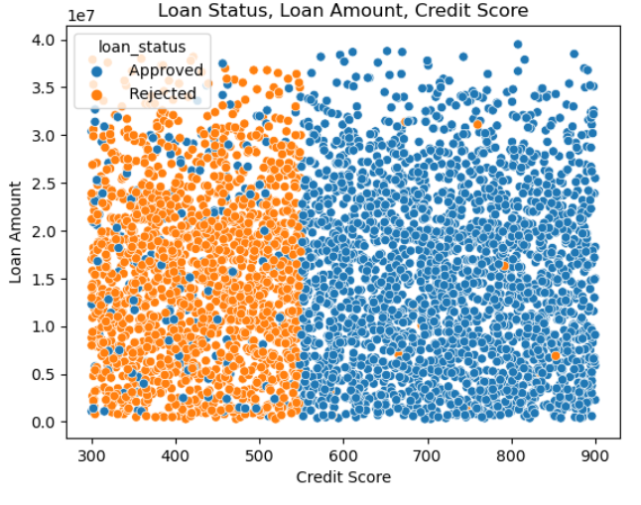
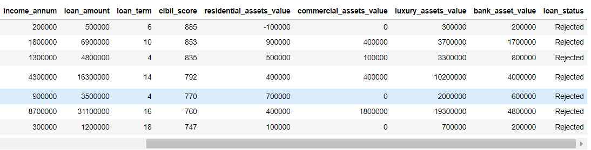
Exploratory data analysis (EDA) & Modelling
This finding is noteworthy:
Credit scores in the range of 540 to 550 distinctly separate loan statuses into two categories, indicating a strong correlation.
Interestingly, even individuals with "poor" credit scores above 540 to 550 still have a reasonable chance of approval, potentially due to lender flexibility.
However, a puzzling trend emerges: Some applicants with high credit scores, especially above 740, were still rejected, often for small loan amounts. The question is: what factors led to their rejection?
Upon creating the subset, we've uncovered an interesting pattern where over five applicants with credit scores exceeding 740 experienced loan rejections. To delve deeper into the reasons behind this, our attention is drawn to four specific features: 'residential_assets_value,' 'commercial_assets_value,' 'luxury_assets_value,' and 'bank_asset_value.' Given that the dataset lacks descriptions for these variables, we'll conduct some research to gain a clearer understanding of what these features represent.
Credit Score

Slide 8
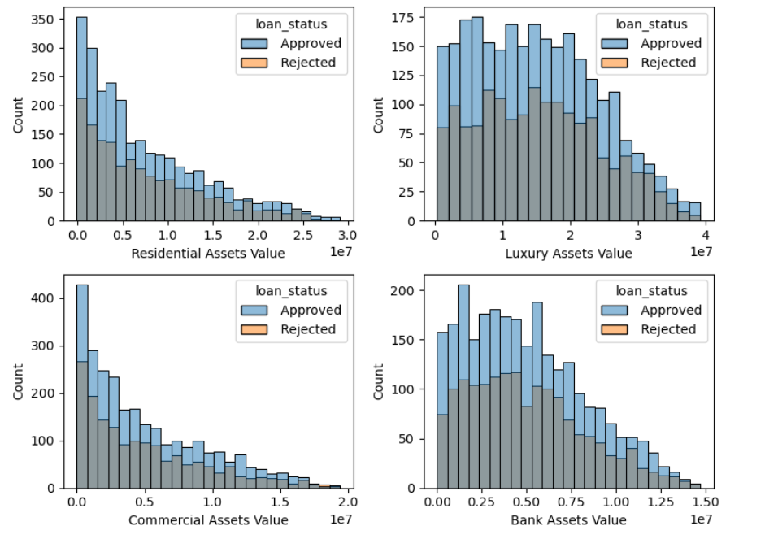
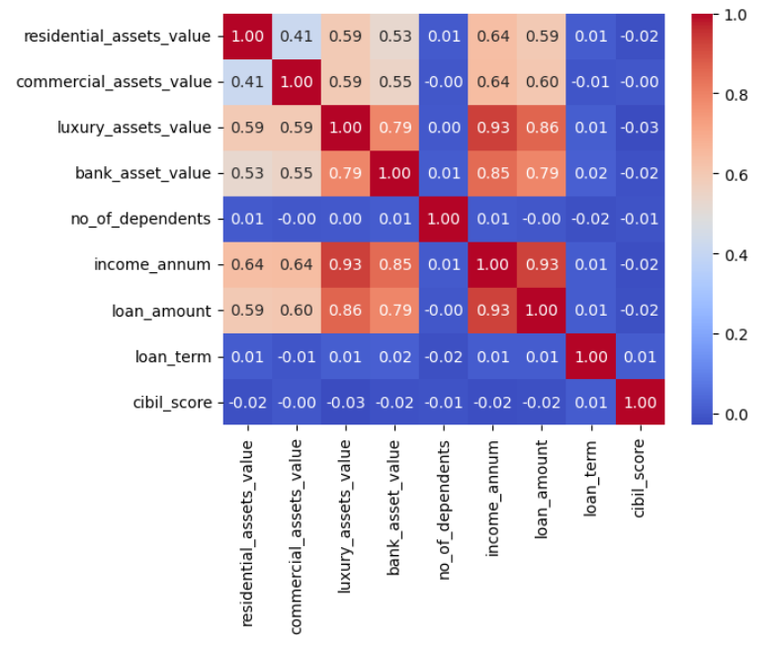
Exploratory data analysis (EDA) & Modelling
Similar to the loan amount, it's not immediately evident what the distinct trends are between these asset values and loan statuses. To gain deeper insights, we'll need to explore these asset values further and investigate their implications on loan status.
Strong Positive Relationships: Asset values show moderate to strong positive correlations with annual income. Higher annual incomes are associated with greater asset flexibility, particularly in luxury assets.
Correlation Discrepancy: Residential and commercial asset values exhibit slightly weaker correlations with annual income compared to luxury and bank assets. Possible reasons include the nature of assets, economic factors, diverse income sources, data complexity, and the presence of outliers.
residential_assets_value, commercial_assets_value,
luxury_assets_value, bank_asset_value

Slide 9
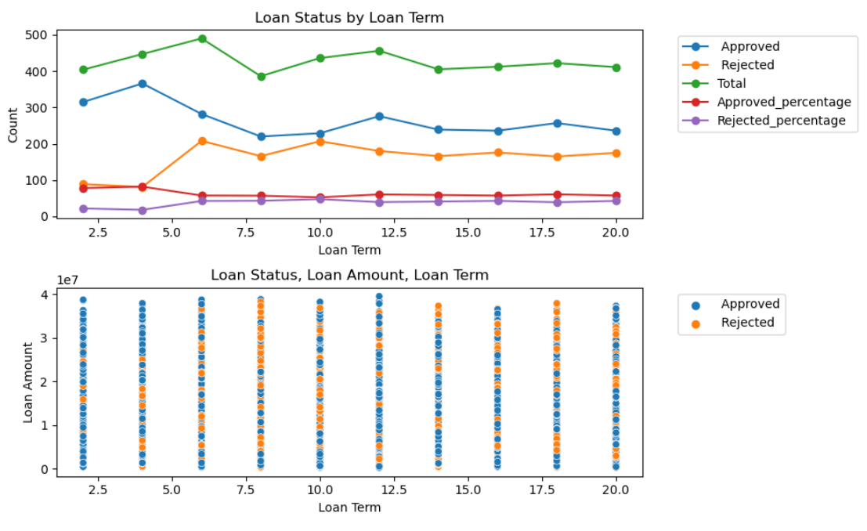
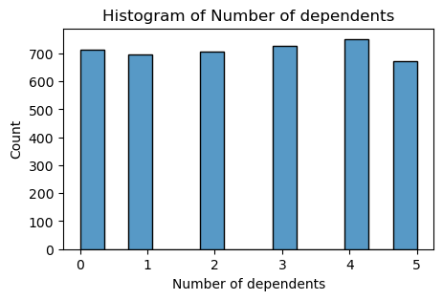
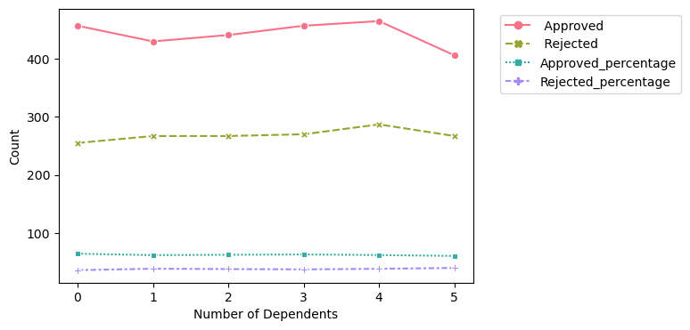
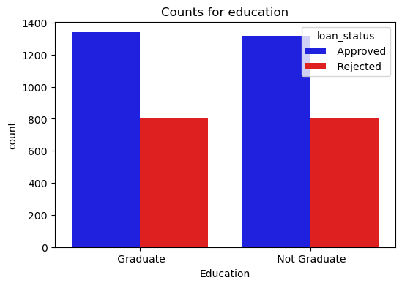
Exploratory data analysis (EDA) & Modelling
there are no significant differences and other variables in this dataset.
Loan Term, Self Emplyed, Number of Dependents and Education

Slide 10
MACHINE LEARNING

Slide 11
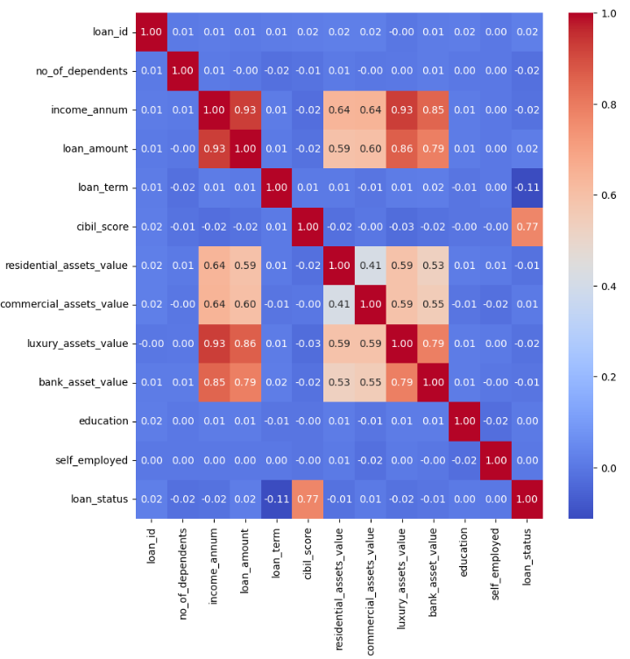
Machine LEArning
The most influential variable affecting loan_status is cibil_score.
There's no observable linear relationship between education and self_employed with other variables.
Strong linear relationships exist between:
income_annum and loan_amount
luxury_assets_value and income_annum
bank_asset_value and income_annum
luxury_assets_value and bank_asset_value

Slide 12
Logistic regression & random forest model
Logistic regression
Random Forest
Accuracy: 0.920
Precision: 0.935
Recall: 0.931
F1 Score: 0.933
Accuracy: 0.972
Precision: 0.975
Recall: 0.978
F1 Score: 0.976
validation data used during model development
Accuracy: 0.973
Precision: 0.979
Recall: 0.978
F1 Score: 0.979
assesses the model's performance on a completely separate and previously unseen dataset, the test data, to ensure that it generalizes well
Given that the Random Forest model outperformed the Logistic Regression model, we have decided to proceed with the Random Forest model.

Slide 13
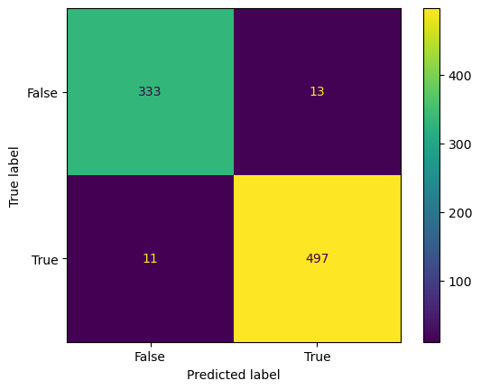
Logistic regression & random forest model
Confusion Matrix
Given that the Random Forest model outperformed the Logistic Regression model, we have decided to proceed with the Random Forest model.

Slide 14
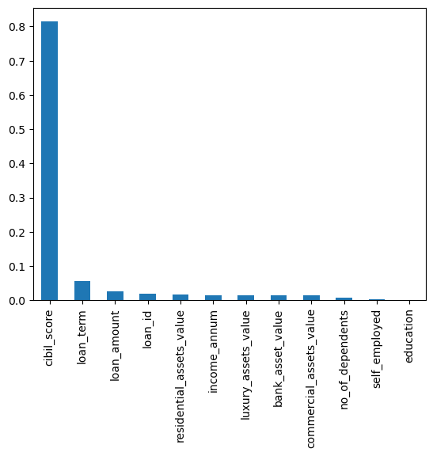
Logistic regression & random forest model
Feature Importance (Descending Order)
Our analysis has highlighted cibil_score as the most influential factor affecting our model's predictions. This prominence may be attributed to the strong relationship between cibil_score and the target variable, loan_status.

Slide 15
Evaluation & Recommendations
In conclusion, this data analysis project was initiated to unravel the intricate relationships between various variables within a dataset and their impact on loan approval status. Through an extensive exploratory data analysis (EDA), we scrutinized key features, including loan amount, annual income, loan term, asset values, and demographic factors.
Future research endeavors could delve deeper into qualitative aspects such as loan purpose, borrower credit history, and economic conditions. Additionally, a broader spectrum of features and advanced machine learning techniques may provide a more nuanced understanding of loan approval dynamics.
We can also use Statistic Method to evaluate the the insights gained can serve as a compass for data-driven decision-making within the lending industry, aligning with our initial problem statement's pursuit of enhancing lending institutions' decision-making processes with data-driven insights.

Slide 16
THANK YOU
Abdul Rahim bin Saidi​

